Slide 1
Facial Recognition and Identification: Enhancing Event Operations
Mooyoung Lee, Vivek Bejugama, and Brian Lee

Slide 2
Presentation Contents
Introduction and Context to the Problem
Proposed Solution
Methods
Proof of Concept
Conclusions and Future Considerations

Slide 3
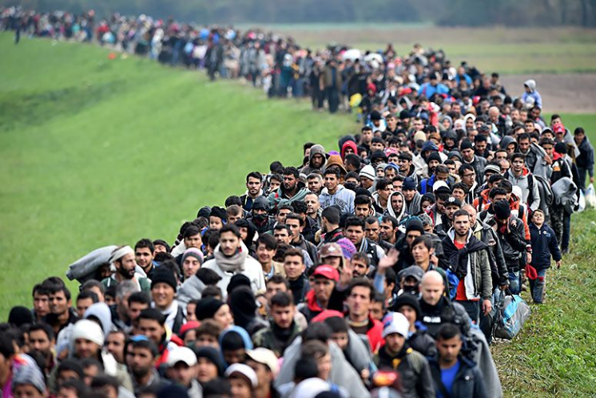
Refugee Support Logistics
Thousands of refugees
2016 || 85,000
2017 || 54,000
Texas is one of the major hubs
Challenges for community support:
Language/Culture barriers
Employment/education
Discrimination/racism

Slide 4

The Organization
Love Is Ministry
After school learning
Adult learning
Citizenship classes
Mentorships

Slide 5
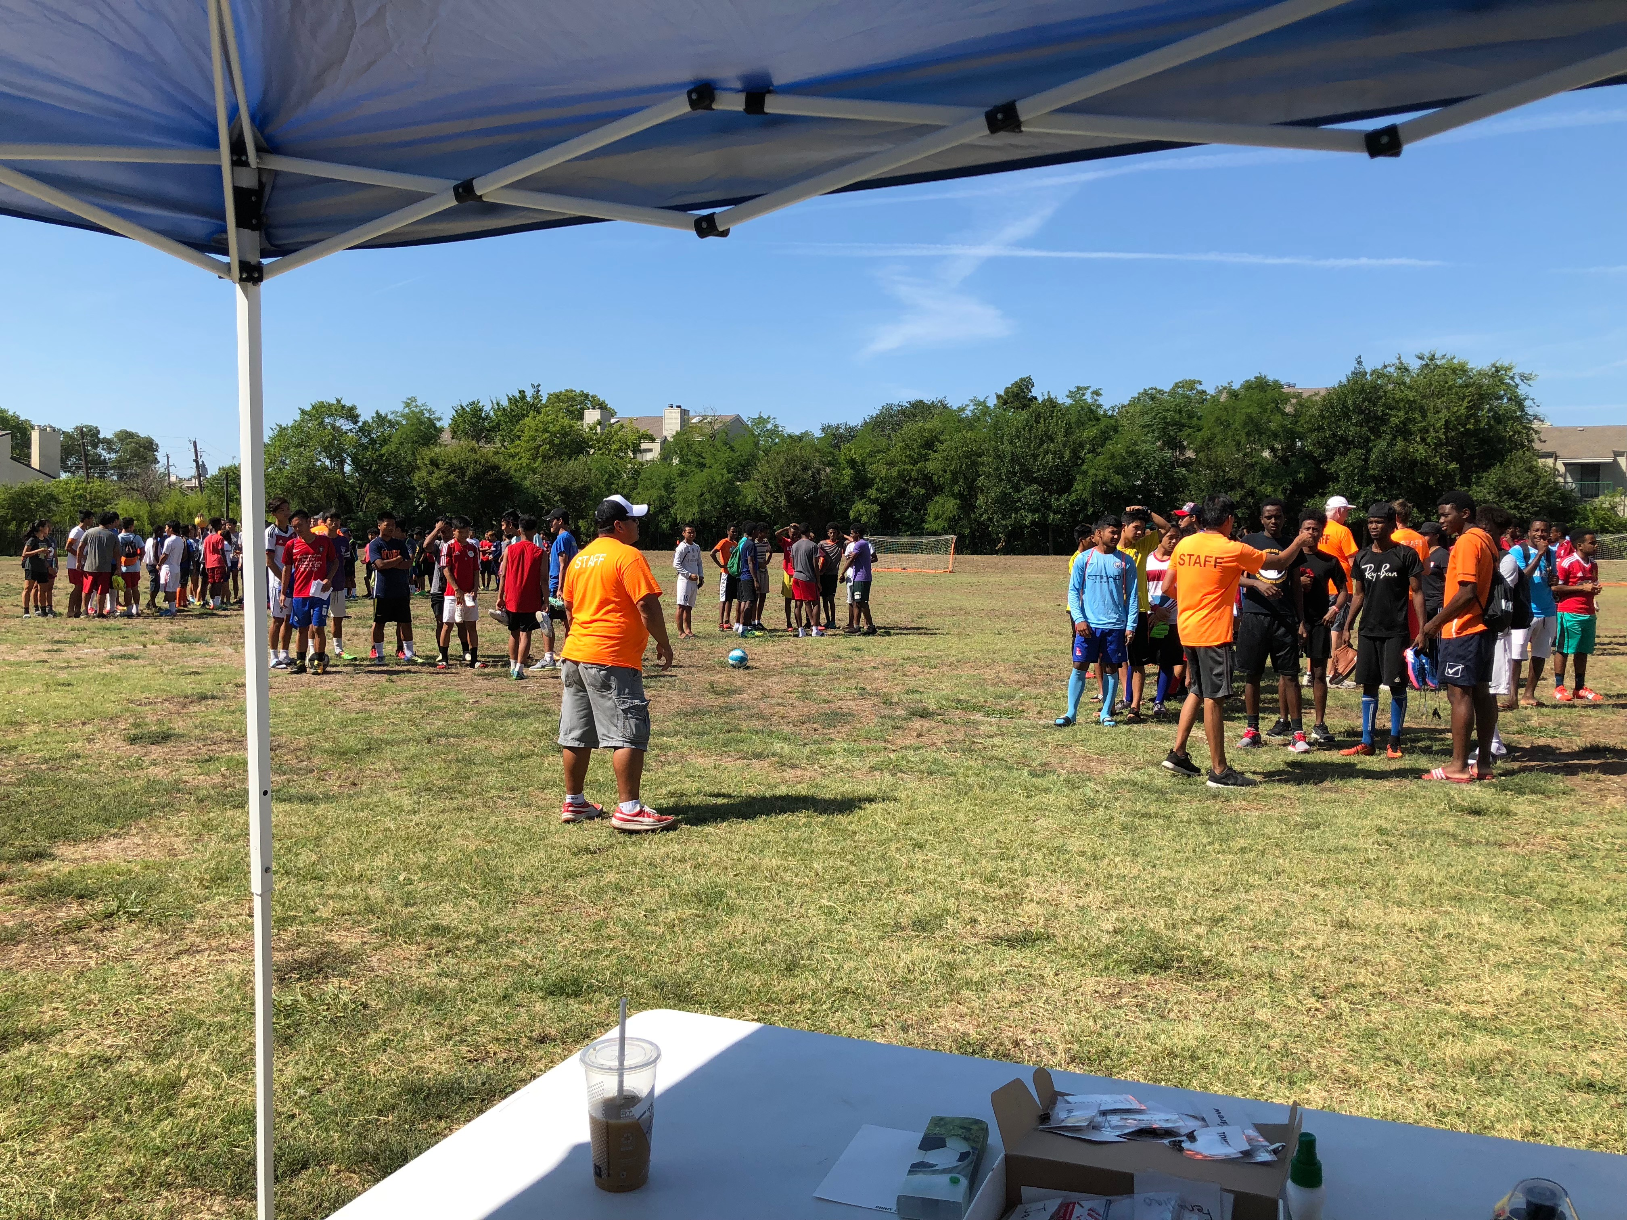
The Problem
Summer soccer league
Hundreds of kids
Limited staff
Event operations logistics

Slide 6
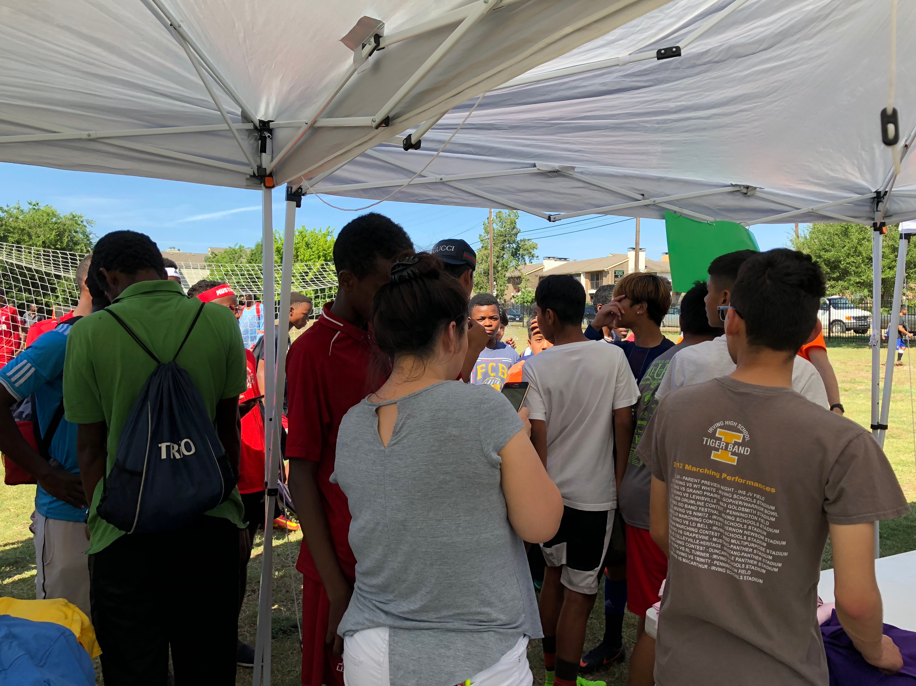
The Problem
Event registration
Registration of unregistered teams
Player tracking
Multiple manual input via web form for each player
Language barriers
Potentially takes hours before even the first game begins

Slide 7
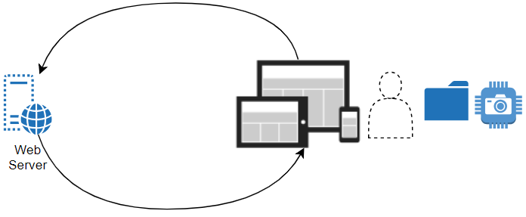
Current Process/Infrastructure

Slide 8
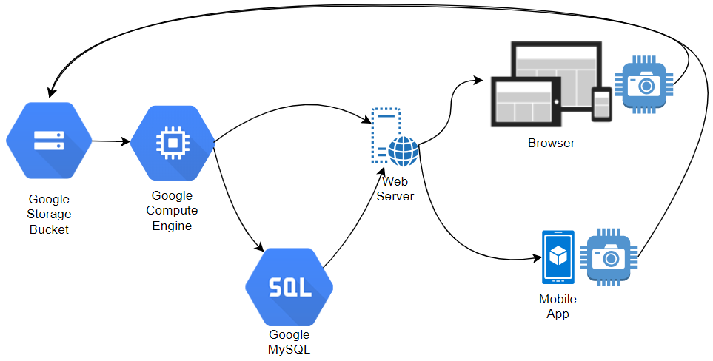
Proposed Infrastructure

Slide 9
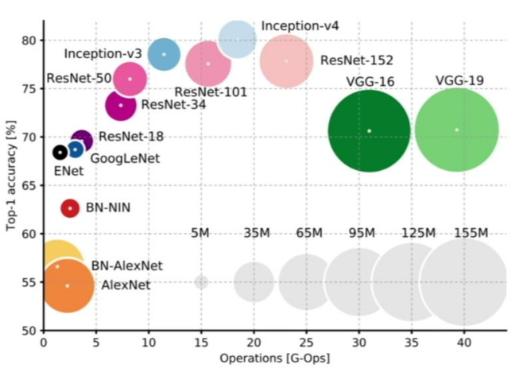
Image Classification
ImageNet
A project which classifies and maintains DB of images in different categories.
Transfer Learning
Transfer of learnings from one algorithm to other

Slide 10
Image Classification
Convolutional Neural Network (CNN)
VGG16
InceptionV3
Residual Network
ResNet50 - 50 layers
ResNet152 – 152 layers

Slide 11
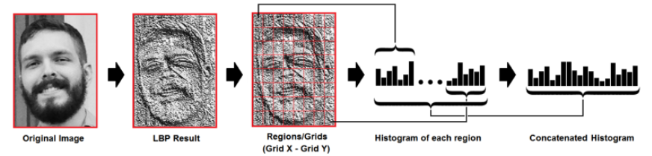
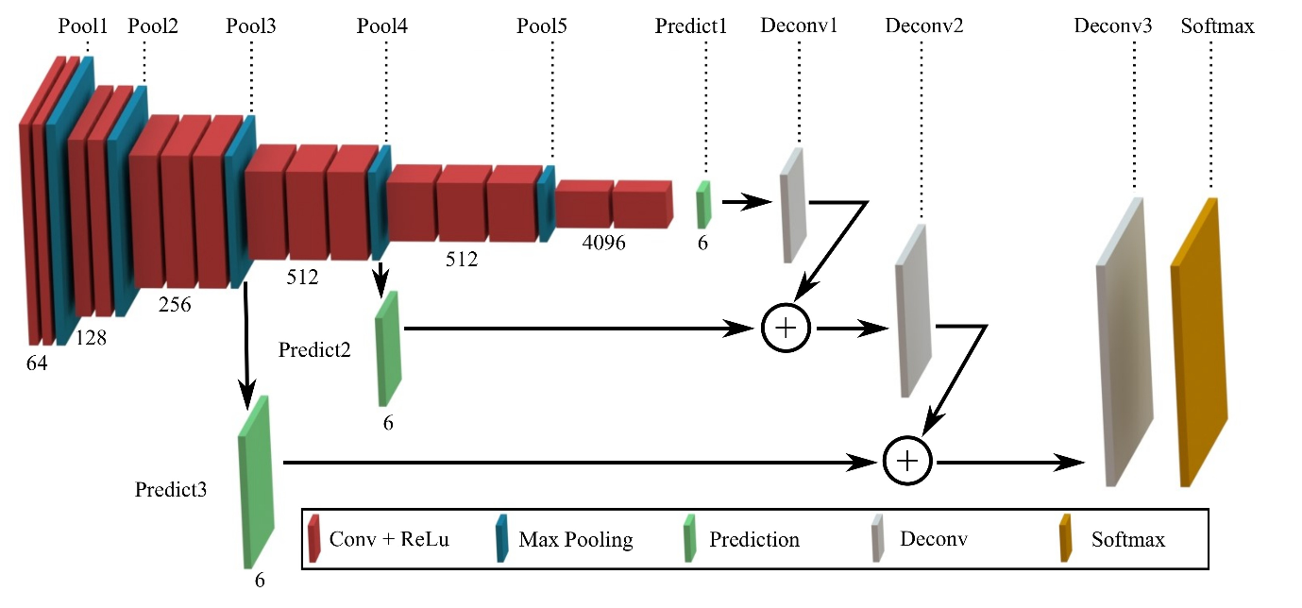
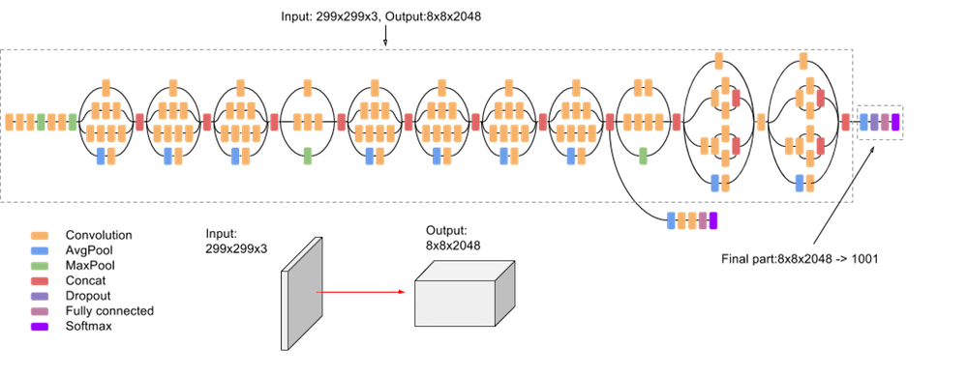
Model selection
LBPH
https://towardsdatascience.com/face-recognition-how-lbph-works-90ec258c3d6b
OpenCV library
Local Binary Patterns Histograms (LBPH)
CNN model via Transfer learning
VGG16
Inception V3
VGG16
https://blog.playment.io/semantic-segmentation-models-autonomous-vehicles/
recognizer = cv2.face.LBPHFaceRecognizer_create()
recognizer.train(x_train, np.array(y_labels))
recognizer.predict(img_gray)
Inception V3
https://cloud.google.com/tpu/docs/inception-v3-advanced

Slide 12






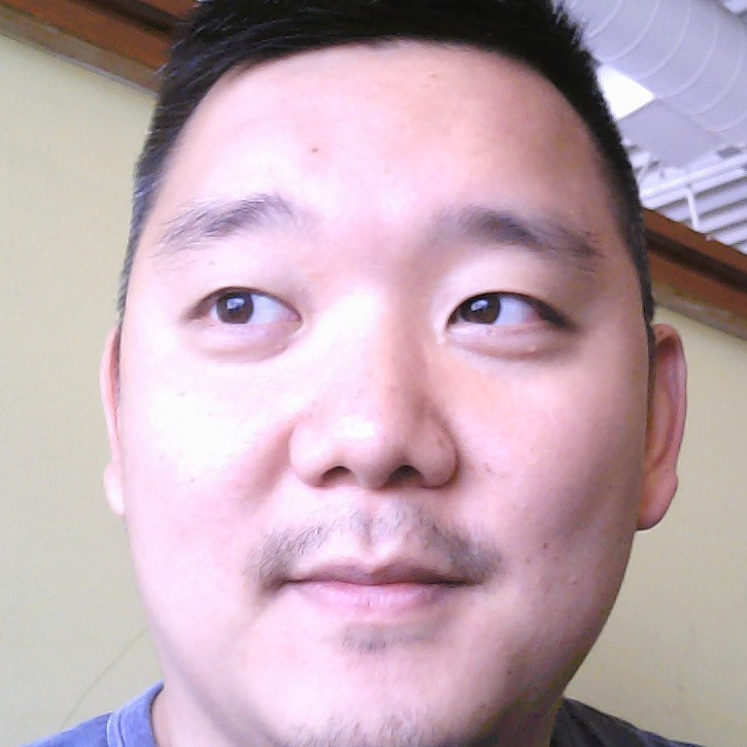
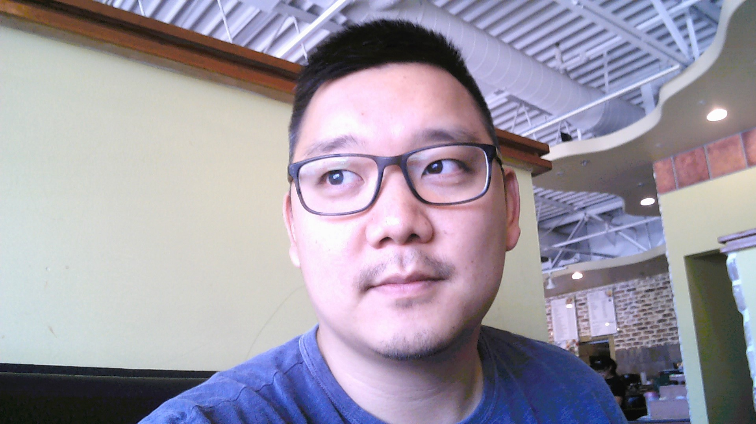
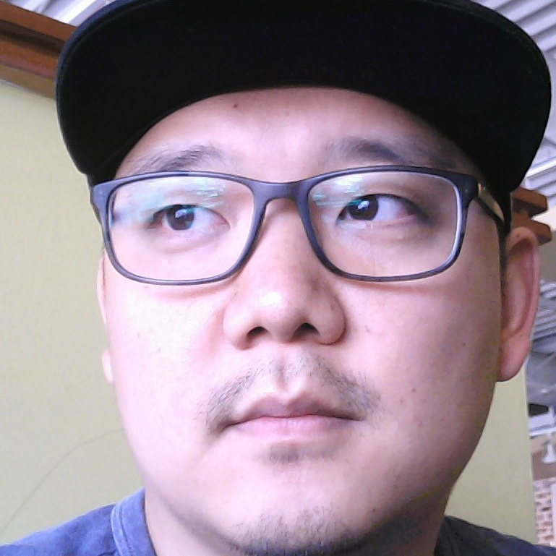
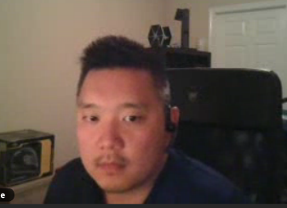

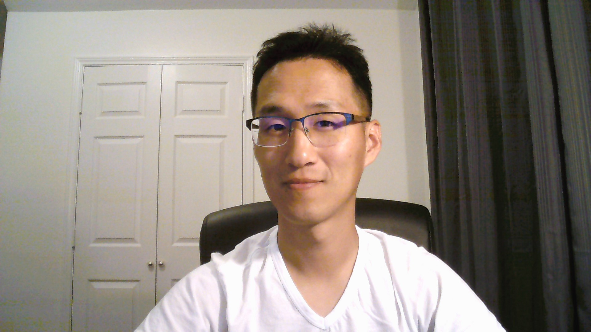
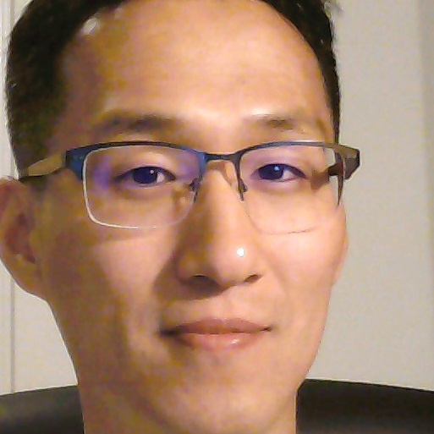
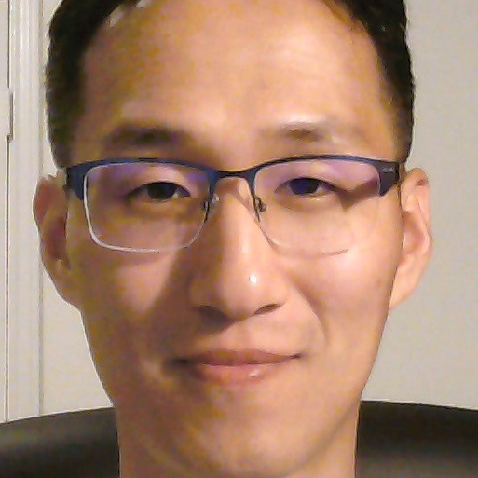
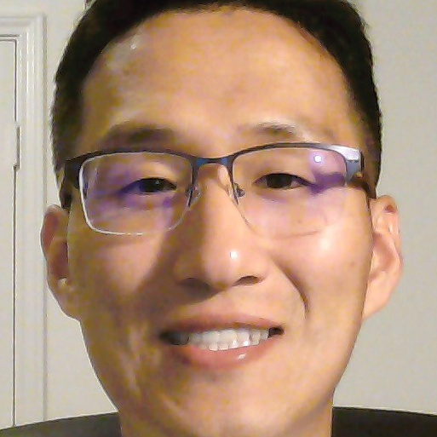
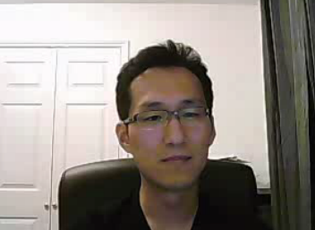
Data set
Train set (33 photos)
Validation set (22 photos)
11 people

Slide 13
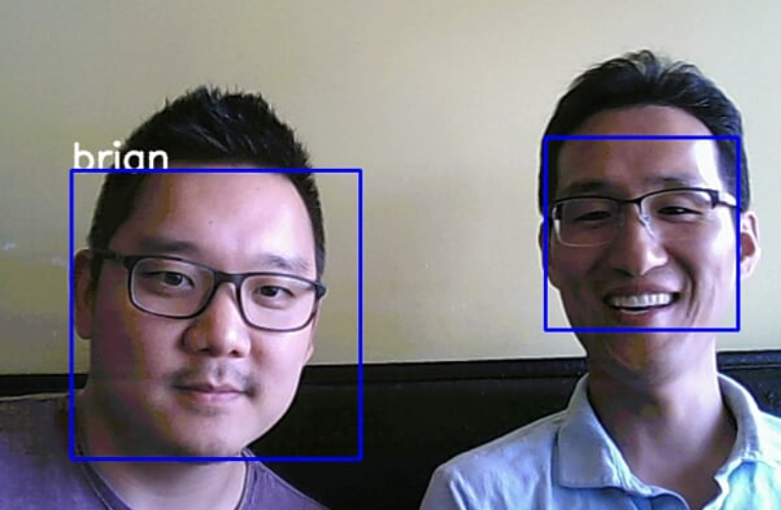
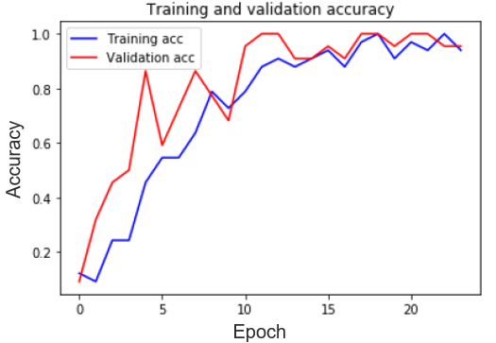
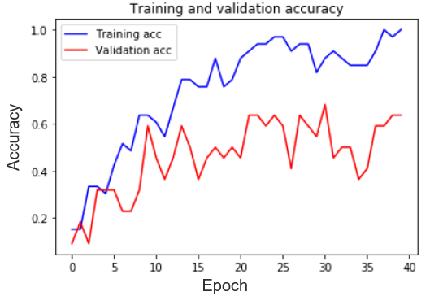
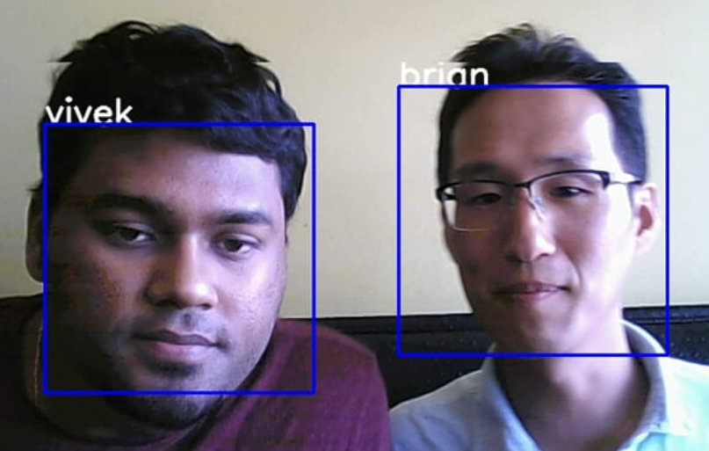
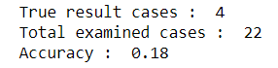
Model selection - Accuracy
LBPH : 18%
VGG16 : 90%
InceptionV3 : 60%

Slide 14
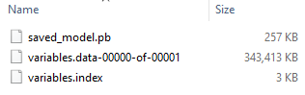
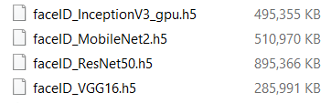
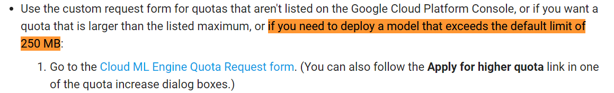
Trial 1 – Local model + Cloud ML API
Train CNN model locally via transfer learning
Upload the CNN model into google storage bucket
Load model into Cloud ML API and predict
Google ML API model format
Keras saved models
Google document
https://cloud.google.com/ml-engine/docs/tensorflow/quotas#requesting_a_quota_increase

Slide 15
Trial 2 – Train and Deploy using Cloud ML
Preprocess Images with Cloud Dataflow
Train the Model with Cloud ML API (Transfer learning w/ Inception V3)
Deploy the Trained Model for Predictions
Tutorial:
https://codelabs.developers.google.com/codelabs/cpb102-txf-learning/index.html#0

Slide 16
Trial 3 – Local model + Compute instance
Create a Python environment on a compute instance
Run a script to load a model
Run a script to predict a name by grabbing an image from the test folder

Slide 17
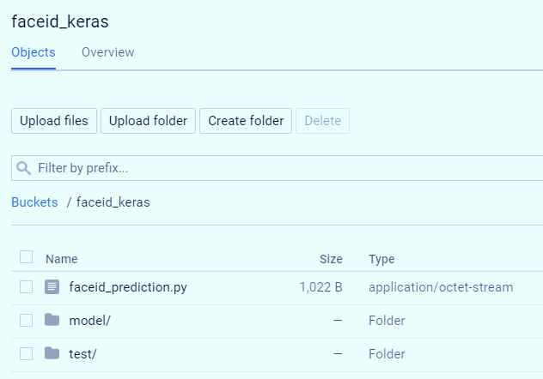
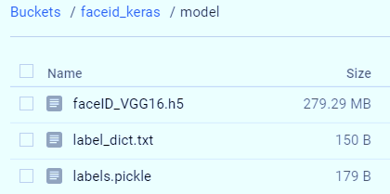
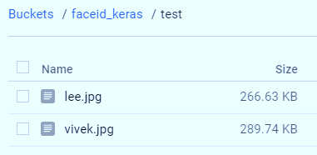
Trial 3 – Storage Bucket

Slide 18
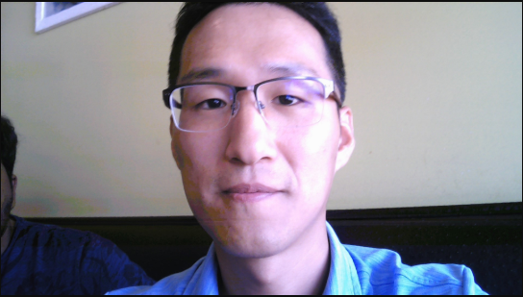

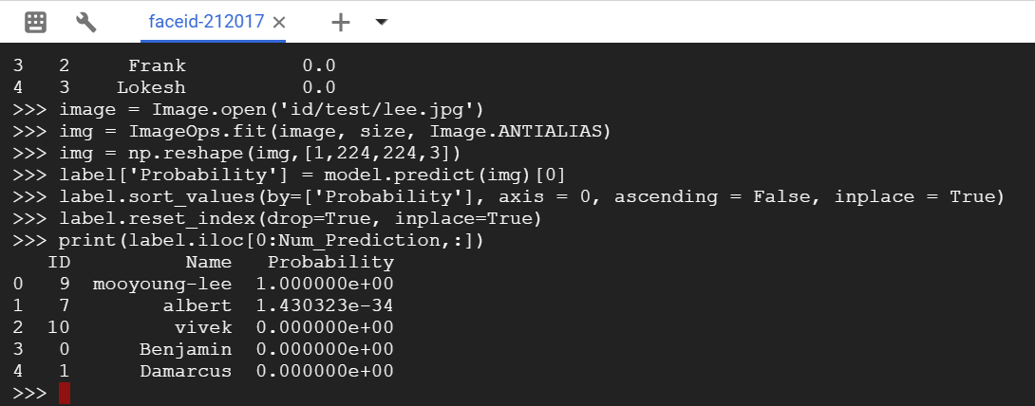
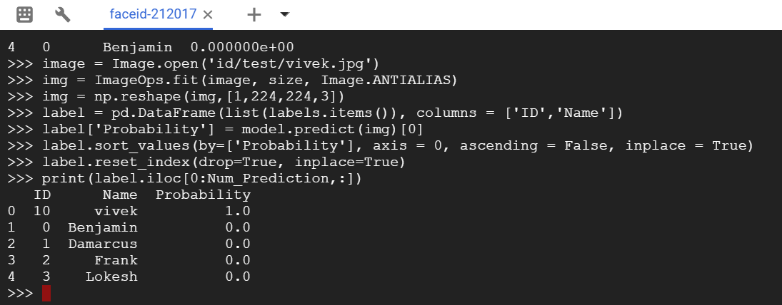
Trial 3 – Prediction
Prediction w/ “lee.jpg”
Prediction w/ “vivek.jpg”

Slide 19
Challenges
Gaining permission from lead stakeholders
Event Organizer (Leader)
Technical Team
Operation Enhancements
Obtaining buy-in from the organization
Selling the idea

Slide 20
Conclusion and Future Considerations
The concept of a face identification model using cloud infrastructure was successful.
CNN model vis transfer learning is better than OpenCV/LBPH model.
CNN model using VGG16 was better than the InceptionV3 for our application.
Need to validate the CNN model w/ about 100-people.
Need to develop a user-friendly app to communicate with cloud ML instance.

